Slide 1

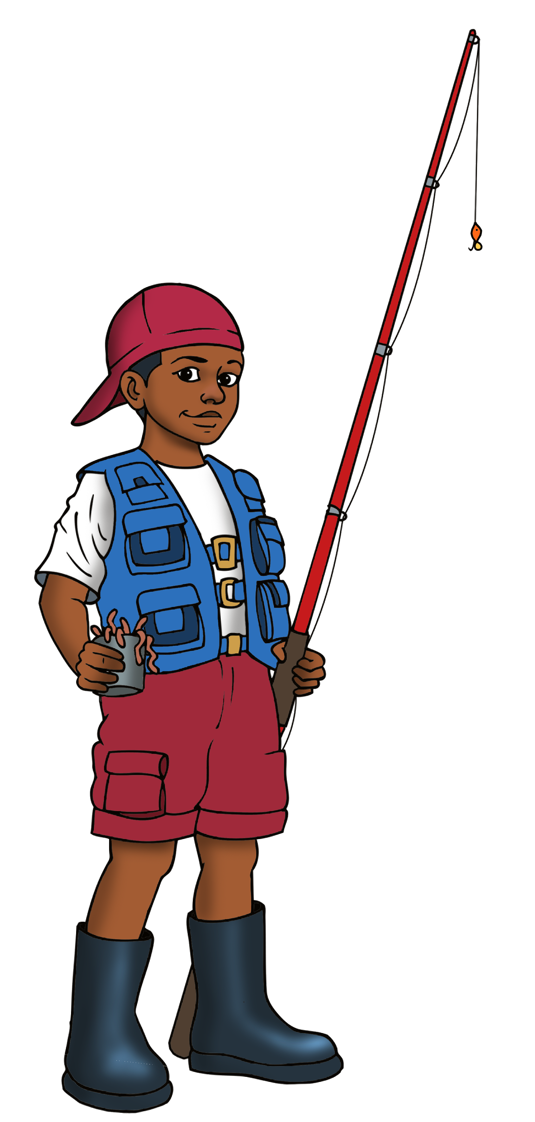

Announcing VBS 2026

Slide 2

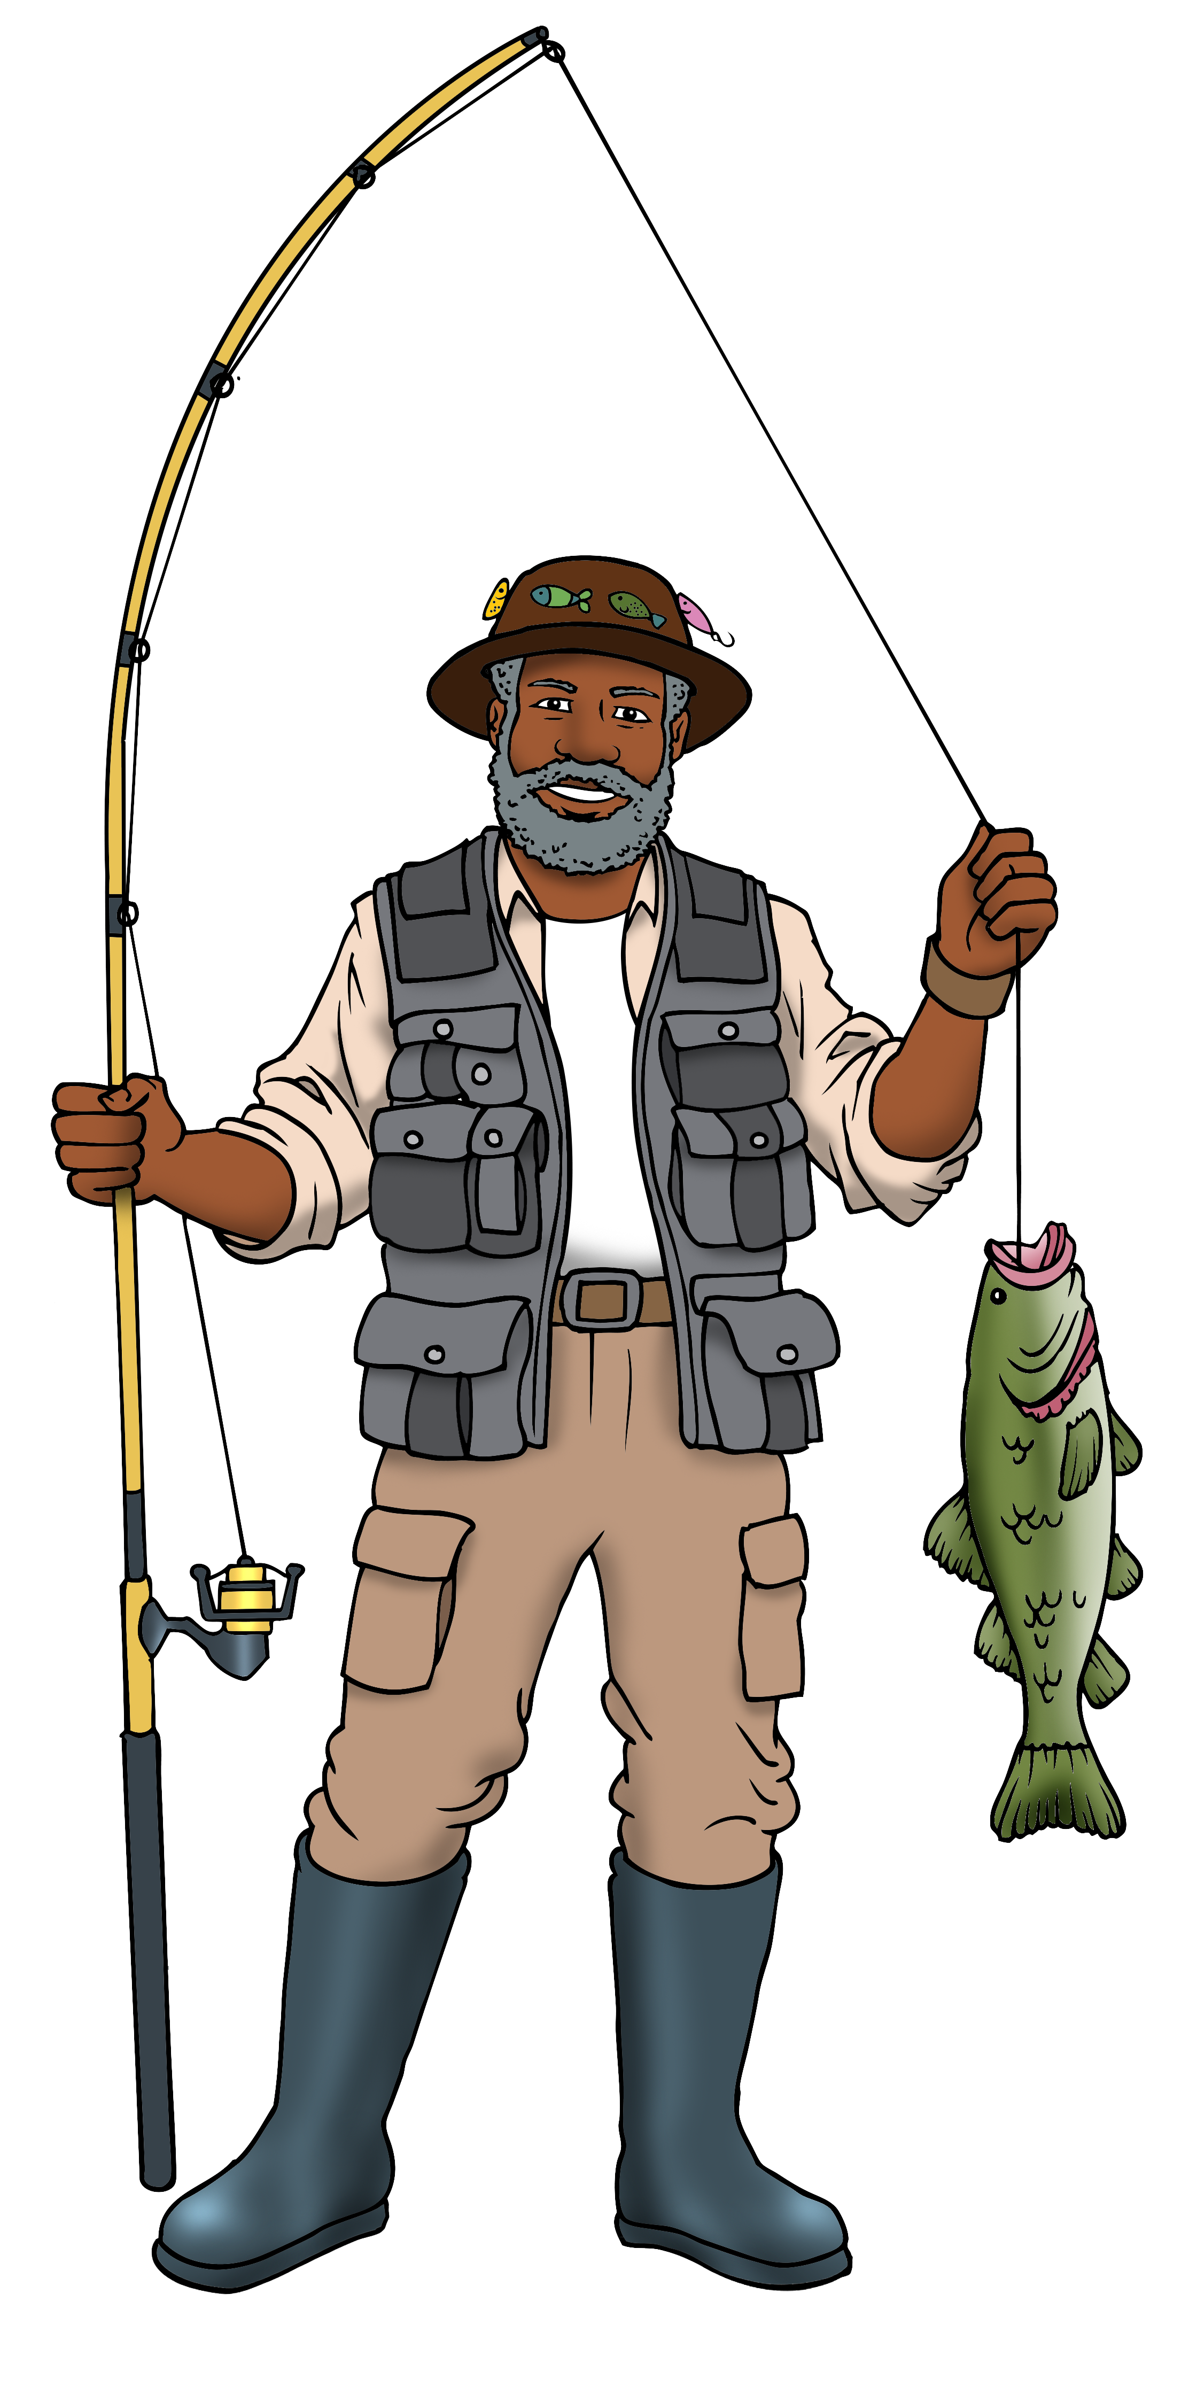

WELCOME TO
VBS 2026
WORKER’S TRAINING
Church Name: _______________________
Pastor’s Name: ______________________
Date: ___________________________

Slide 3

Motto:
I’m Hooked!
Theme Verse: Jesus called out to them, “Come, follow me, and I will show you how to fish for people!”
~ Matthew 4:19, NLT

Slide 4
Theme Overview
In this year’s VBS, participants will . . .
Grow in their desire to know God
and make God known.
Learn to fish for those who need to hear and come into the knowledge of God’s saving grace.

Slide 5

Daily Expeditions
Day 1: Hooked! Grace when Reeled In
Lesson Scripture: Jonah 1:1-4, 12-17; Jonah 2:9-10; Jonah 3:1-3a
Day 2: Hooked! My Testimony Is My Bait
Lesson Scripture: John 4:7-15, 28-30, 39-42
Day 3: Hooked! Being Sent
Lesson Scripture: Luke 10:1-12, 17-20

Slide 6
Daily Expeditions
Day 4: Hooked! Spreading the Good News
Lesson Scripture: Matthew 28:8-20
Day 5: Hooked! Sharing Your Fish
Lesson Scripture: John 6:1-15 (Children)
Hooked! Serving in the Marketplace
Lesson Scripture: Acts 17:16-34 (Youth/Adults)

Slide 7

FISHING EXPEDITION—Day 1
HOOKED! Grace when
Reeled In
Sinker (Key Verse):
“I, with shouts of grateful praise, will sacrifice to you. What I have vowed I will make good. I will say, ‘Salvation comes from the Lord.” (Jonah 2:9, NIV)
Cast (Lesson Scripture):
Jonah 1:1-4, 12-17; 2:9-10; 3:1-3a
Daily Catch:
God gives us grace, even when we delay,
to fulfill our vows to Him.

Slide 8
FISHING EXPEDITION—Day 2
HOOKED! My Testimony
Is My Bait
Sinker (Key Verse):
“Come, see a man who told me everything I ever did.
Could this be the Messiah?” (John 4:29, NIV)
Cast (Lesson Scripture):
John 4:7-15, 28-30, 39-42
Daily Catch:
God gave each of us a testimony,
and there is power in my story.

Slide 9
FISHING EXPEDITION—Day 3
HOOKED! Being Sent
Sinker (Key Verse):
“The harvest is plentiful, but the workers are few. Ask the Lord of the harvest, therefore, to send out workers into his harvest field.” (Luke 10:2, NIV)
Cast (Lesson Scripture):
Luke 10:1-12, 17-20
Daily Catch:
The harvest is ready, and God invites us
to say yes to being sent out.

Slide 10
FISHING EXPEDITION—Day 4
HOOKED! Spreading the Good News
Sinker (Key Verse):
“Therefore go and make disciples of all nations, baptizing them in the name of the Father and of the Son and of the Holy Spirit.” (Matthew 28:19, NIV)
Cast (Lesson Scripture):
Matthew 28:8-20
Daily Catch:
When we diligently spread the Good News
of God’s saving grace, we fulfill
the Great Commission.

Slide 11
FISHING EXPEDITION—Day 5
HOOKED! Sharing Your Fish
(Children)
HOOKED! Serving in the Marketplace (Youth/Adults)
Sinker (Key Verse):
“In [God] we live and move and have our being.”
(Acts 17:28a, NIV)
Cast (Lesson Scripture):
John 6:1-15 (Children)
Acts 17:16-34 (Youth/Adults)
Daily Catch:
God calls young and seasoned Christians
to use our resources and gifts
to serve others.
DAY 5:
Key Verse (Sinker):
Lesson Scripture
Daily Nugget: God calls young and seasoned Christians to use our resources and gifts to serve others.

Slide 12
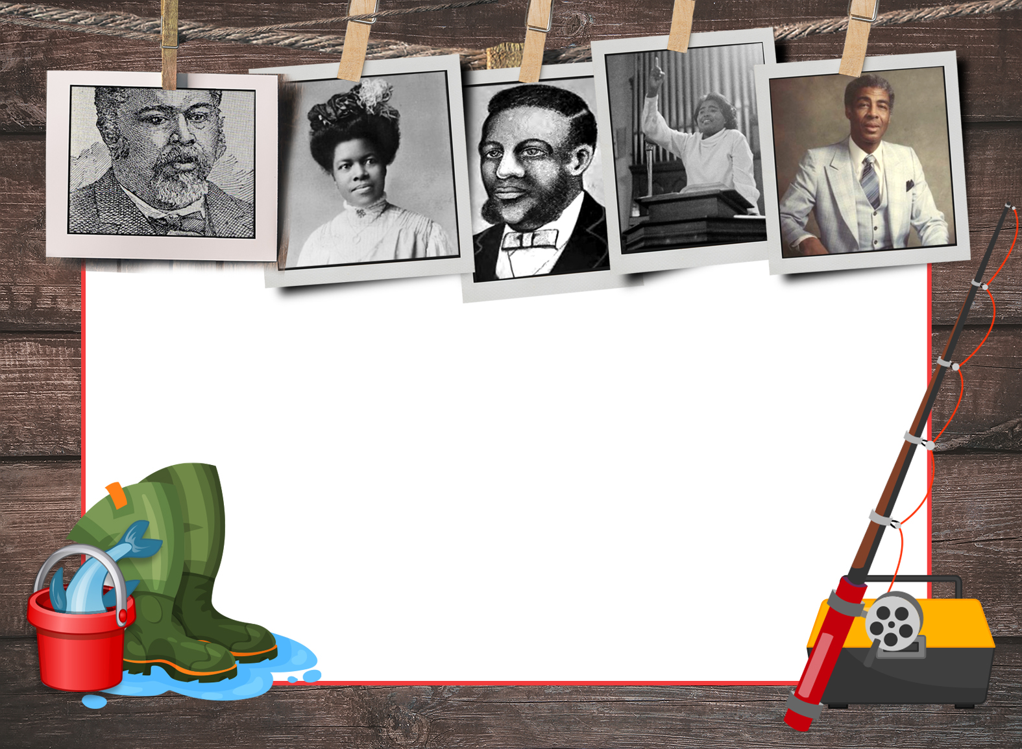
Black History Anglers
(Evangelists and Missionaries)
George Liele
Nannie Helen Burroughs
Lott Carey
Prathia Hall
Kelly Miller Smith Sr.

Slide 13


Hopes for VBS
[Insert your church’s name
here and a few hopes
for this year’s VBS.]

Slide 14
VBS Schedule of Events
[Insert your church’s schedule here.]

Slide 15

Worker’s Covenant
[Your Church Name] • [Your church address]
Volunteer Name _________________________________________ Department/Class _______________________
THE VACATION BIBLE SCHOOL WORKER’S COVENANT
Recognizing that the privilege of guiding people in the Christian way of life is worthy of my best, I covenant, as a worker in the Vacation Bible School ministry of my church, to strive to be faithful first to God, then to the work of ministry.
With God’s help and grace, I humbly and earnestly pledge myself to the following standards, which our church has adopted—believing them to be in accordance with His plan:
I will at all times manifest a deep spiritual concern for the welfare of the members of my class. My first desire shall be to bring about the salvation of each child who does not know the Lord Jesus Christ, and to encourage the spiritual growth of those who do. I will endeavor to have all in my class attain a high standard of regularity, punctuality, preparation of lesson, offerings, prayers, etc. (2 Timothy 2:2)
As a worker of this Vacation Bible School, I will teach in accordance with its doctrines—abstaining from all appearances of evil—and will set an example in dress, conversation, Christian deportment, and prayer. (1 Thessalonians 5:22-23)
I will use my gifts, cooperate wholeheartedly in the plans and activities of the church and the VBS, and attend all VBS worker’s meetings and/or worker training preparation sessions. (Acts 20:27; 1 Corinthians 3:9; 2 Timothy 2:15)
I will not allow my own reputation or that of our church to be hurt in any way as a result of my behavior with the children. In order to avoid any appearance of evil (1 Thessalonians 5:22), I will at all times avoid the following:
  Being alone with a child, unless he or she is my own child;
  Carrying an older child, sitting him or her on my lap, or hugging with full body contact;
  Touching a child in an inappropriate or rough manner; or,
  Talking to a child with an inappropriate tone or manner.
If at any time, through sickness or any other emergency, I am unable to teach my class, I will, if at all possible, get in touch with the VBS Director as soon as possible. I will at all times strive to arrive at VBS 15-30 minutes prior to the beginning of the day’s session.
Signed: ____________________________________________ Date: _______________

Slide 16
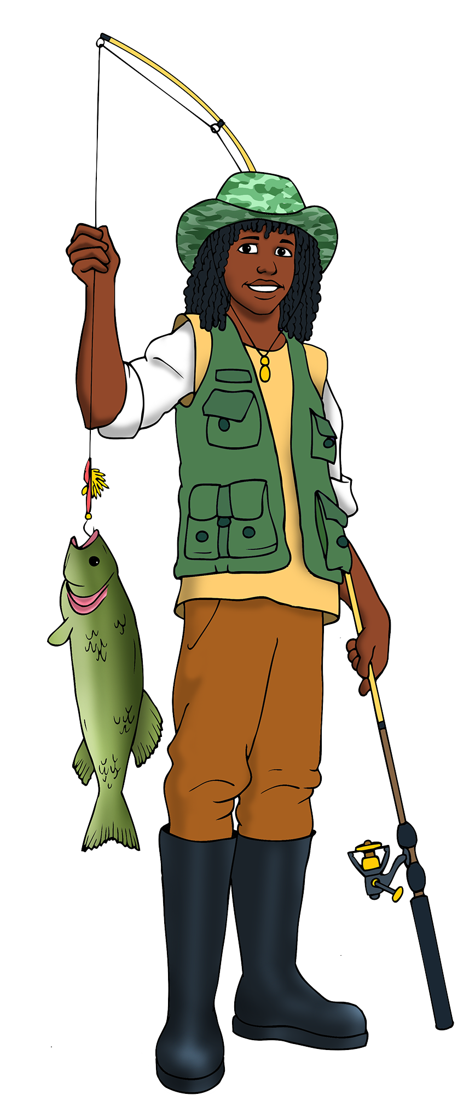

Questions and answers

Slide 17
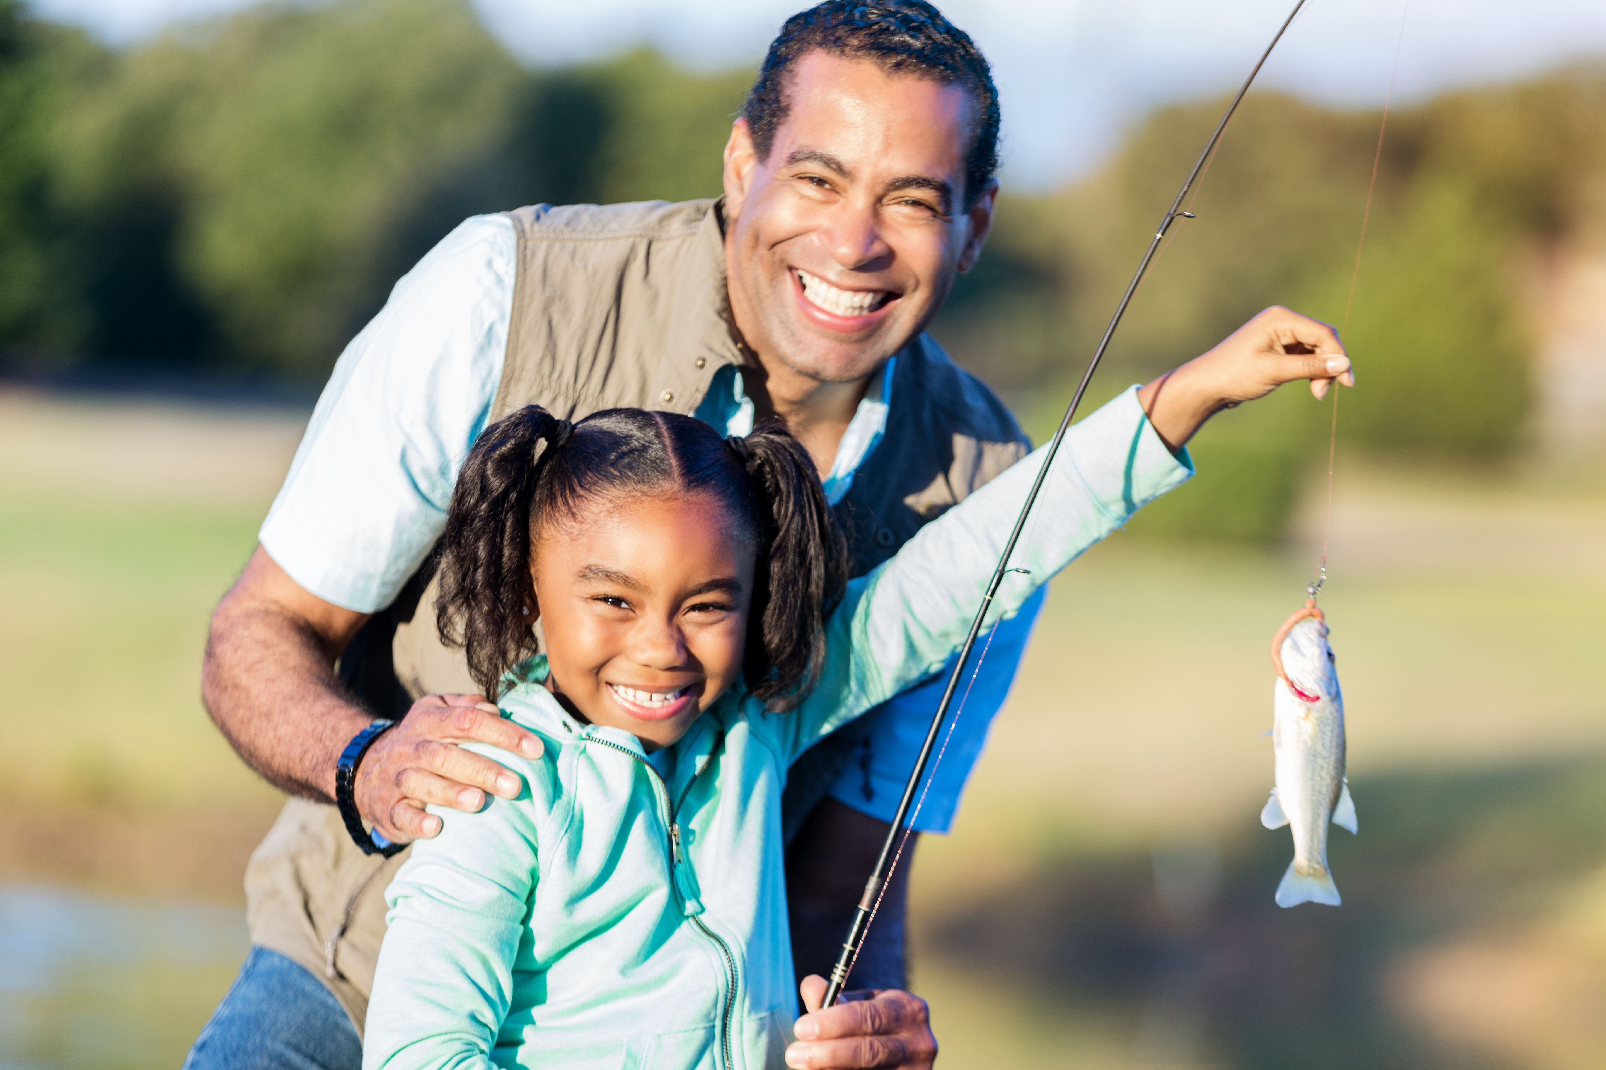
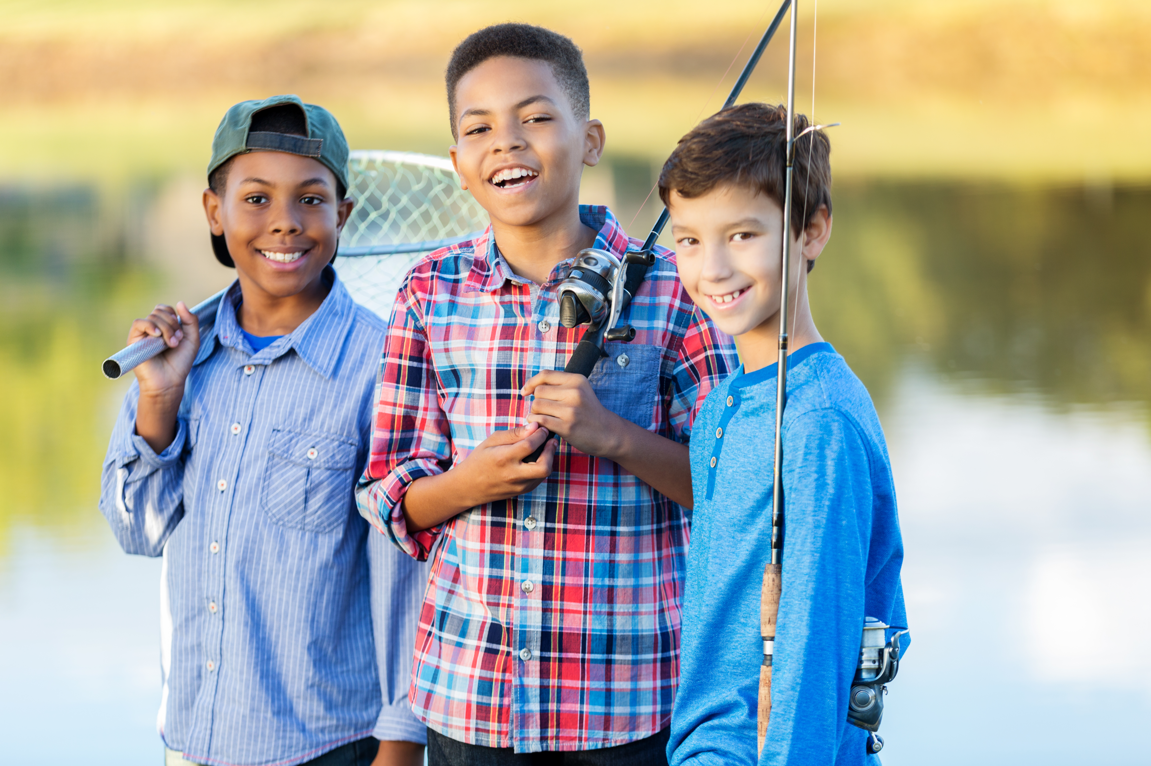
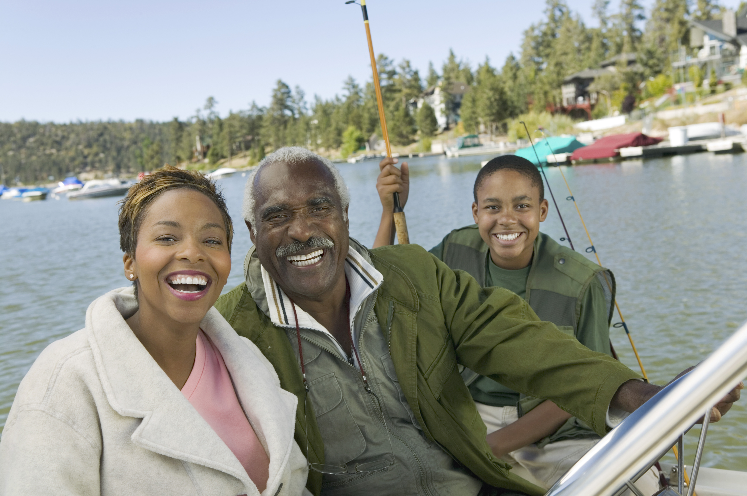
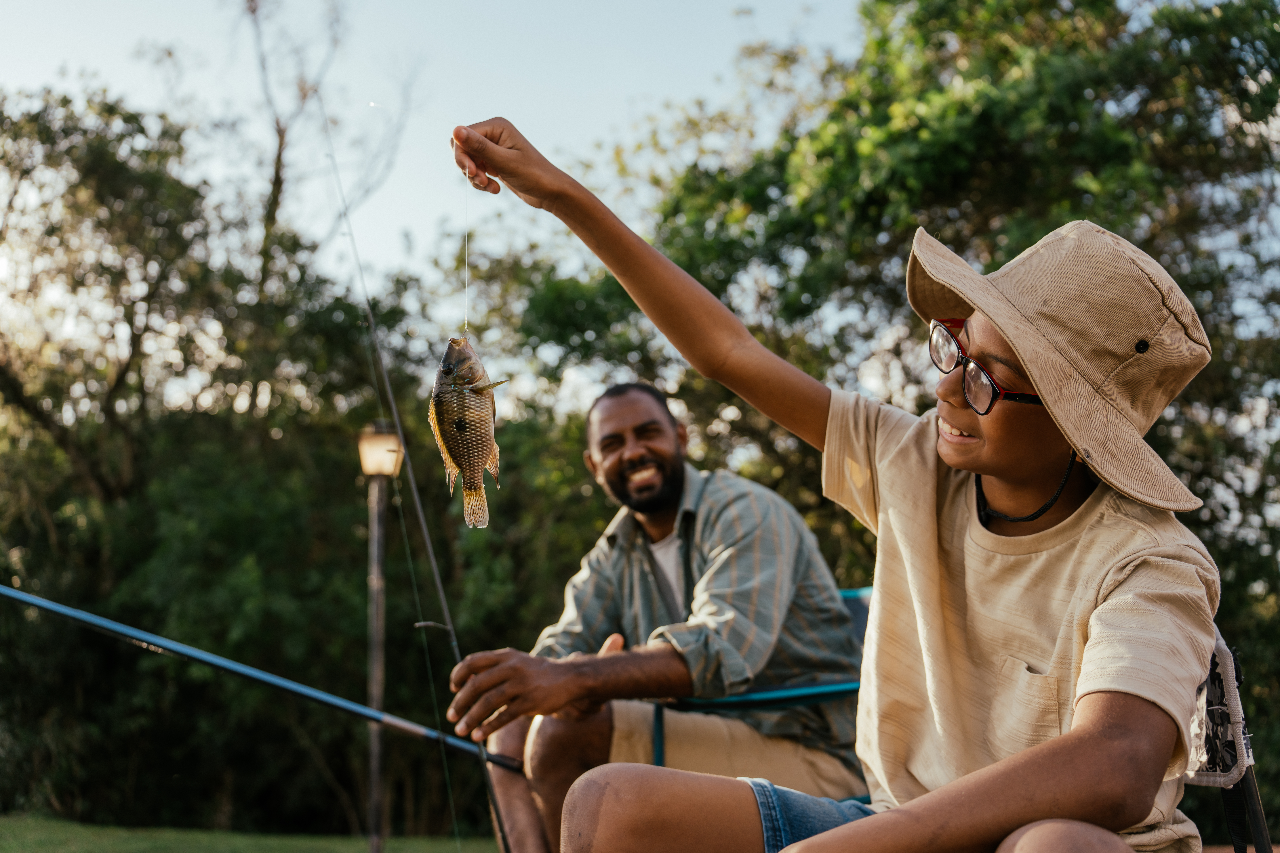
Close in prayer

