Slide 1
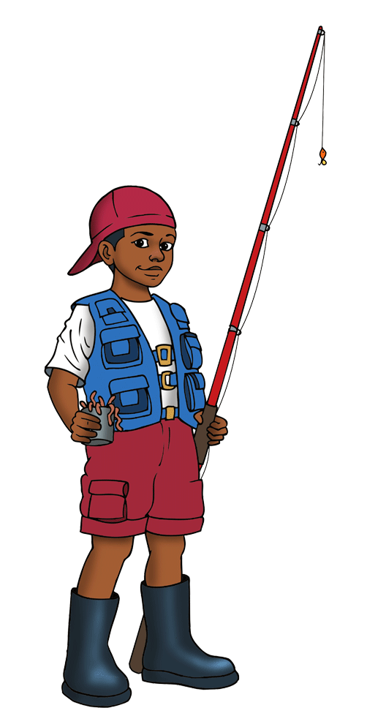


VACATION BIBLE SCHOOL
OPENING ASSEMBLY

Slide 2

Welcome to VBS
[Insert Your Church Name]
[Insert Date]

Slide 3

Key verse
[Insert Key Verse for the Day]

Slide 4

prayer

Slide 5



^{Pledge to the Christian Flag}
I pledge allegiance to the Christian flag,
and to the Savior for whose kingdom it stands;
one family of God, uniting all Christians in service and love.
^{Pledge to the Bible}
I pledge allegiance to the Bible,
^{God’s Holy Word.}
I will make it a lamp unto my feet
^{and a light unto my path.}
I will hide its words in my heart
that I might not sin against God.
^{Pledge to the American Flag}
I pledge allegiance to the flag
of the United States of America,
and to the Republic for which it stands;
one nation, under God, indivisible,
with liberty and justice for all.

Slide 6

THEME SONG:
“Hooked On Jesus”
Lyrics by Ahmad Jamal McGhee

Slide 7
THEME SONG:
“Hooked On Jesus”
Lyrics by Ahmad Jamal McGhee
Grab a line, let’s go!
VERSE
God’s desire is that we know Him
And make Him known all over the world
His love for people, His heart for nations
Embracing His mission is following Jesus

Slide 8
Hooked On Jesus (cont.)
PRE-CHORUS
We wanna share
The hope and deliverance He’s given us
We wanna share
Salvation
We wanna share
The love and the faithfulness He’s given us
We wanna share
But we can only do that if we’re

Slide 9
Hooked On Jesus (cont.)
CHORUS
Hooked on Jesus
We can reel them in if we do it His way
(Come on, let’s get)
Hooked on Jesus
We can reel them in if we do it His way
That’s why He said

Slide 10
Hooked On Jesus (cont.)
POST
“Come, follow Me
Come, follow Me now
Come, follow Me, I’ll show you how
Come, follow Me
Come, follow Me . . . now.”
(Come, follow Me, come, follow Me.)

Slide 11
Hooked On Jesus (cont.)
VERSE
God’s desire is that we know Him
And make Him known all over the world
His love for people, His heart for nations
Embracing His mission is following Jesus

Slide 12
Hooked On Jesus (cont.)
PRE-CHORUS
We wanna share
The hope and deliverance He’s given us
We wanna share
Salvation
We wanna share
The love and the faithfulness He’s given us
We wanna share
But we can only do that if we’re

Slide 13
Hooked On Jesus (cont.)
CHORUS
Hooked on Jesus
We can reel them in if we do it His way
(Come on, let’s get)
Hooked on Jesus
We can reel them in if we do it His way
That’s why He said

Slide 14
Hooked On Jesus (cont.)
POST
“Come, follow Me
Come, follow Me now
Come, follow Me, I’ll show you how
Come, follow Me
Come, follow Me . . . now.”
(Come, follow Me, come, follow Me.)
(Recite twice)

Slide 15
ANNOUNCEMENTS
[Insert your church’s
announcements here]

Slide 16

VACATION BIBLE SCHOOL
CLOSING ASSEMBLY

Slide 17

CHANT
WHEN I SAY…
When I say “Jesus,”
You say “Christ”!
“Jesus” (Christ!)
“Jesus” (Christ!)

Slide 18
Announcements and Closing Remarks

Slide 19
THE LORD’S PRAYER
Our Father which art in heaven,
Hallowed be Thy name. Thy kingdom come.
Thy will be done in earth, as it is in heaven.
Give us this day our daily bread.
And forgive us our trespasses,
as we forgive them that trespass against us.
And lead us not into temptation,
but deliver us from evil.
For thine is the kingdom,
and the power, and the glory,
forever and ever. Amen.

Slide 20
(Numbers 6:24-26)
BENEDICTION
May the Lord bless you
and keep you;
May the Lord make
His face shine on you
and be gracious to you;
May the Lord turn
His face toward you
and give you peace.

